Slide 1

DCET-MITWPU
Title: Design and Implementation of a Digital Twin for Subsea System Project Domain: Machine Learning Project Type: In-House Project
Project Guide: Dr. Mangesh Bedekar
Team Members:
Joella Susan Jacob - 1032200637
Urvi Bhavesh Desai - 1032200434
Tanvi Sachin Kulkarni - 1032200891
Nupur Praful Patil - 1032202206

Slide 2
Literature Survey
Publication Year | Positive points in Paper | Research Gaps
2022 (Journal - Sensors) [1] | MQTT protocol and Apache Kafka support Publish - Subscribe technique for establishing communication between the physical and virtual object. For sensors and actuators, that are limited-resource devices, low power consumption protocols like Bluetooth, ZigBee are used. | To develop secure Digital Twins, focusing on enhancing data protection to ensure system reliability. To address challenge of standardizing processes to enhance interoperability.

Slide 3
Literature Survey (Cont’d)
Publication Year | Positive points in Paper | Research Gaps
2022 (Journal - Journal of Marine Science and Engineering) [2] | Paper focuses on assessing automated risk within digital twin. Fatigue calculations are computed based on continually monitoring the asset's structural health and performance metrics. Statistical correlation between environmental conditions (such as sea states, wave frequencies) and fatigue damage is established. | Research needed for developing methods to seamlessly integrate data from various sources into the digital twin platforms. Need to address challenge of standardizing processes to enhance interoperability

Slide 4
Literature Survey (Cont’d)
Publication Year | Positive points in Paper | Research Gaps
2022 (Journal - Journal of Industrial Information Integration) [3] | IoT data accessed using APIs. Simulation and optimisation systems like Advanced Process Control (APC) and Real-Time Optimisation (RTO) help in enhancing the accuracy of the Digital Twin Model. | The absence of standardized metrics hinders the evaluation of DT effectiveness and performance. The paper highlights the challenge of insufficient information on successful DT implementation,hindering comprehensive assessment and comparison.

Slide 5
Literature Survey (Cont’d)
Publication Year | Positive points in Paper | Research Gaps
2021 (Journal - archive.org) [4] | The architecture for using a digital twin for a tool to implement predictive maintenance was proposed. A digital twin for a gas reciprocating compressor was designed with MATLAB for data analysis, Machine Learning for fault diagnosis and ThingSpeak for cloud. Various sensors were connected to the compressor. | Actual implementation of the digital twin did not take place; only sensors were used and a flowchart for an architecture provided.

Slide 6
Literature Survey (Cont’d)
Publication Year | Positive points in Paper | Research Gaps
2020 (Journal - IFAC-PapersOnLine) [5] | Implemented a Front End Engineering Design (FEED) system for gas/oil offshore exploration. Used Building Information Modeling (BIM) to create 3D digital models of various subsea components. Applied Case-Based Reasoning (CBR), an AI technique where they used data from other inoperational offshore facilities to create digital twins and apply the findings to the new system to make predictions. Highlighted the possible applications of such a system to enhance safety, monitoring and maintenance for subsea gas/oil related operations. | Better evaluation methods need to be found for improved accuracy and efficiency.

Slide 7
Literature Survey (Cont’d)
Publication Year | Positive points in Paper | Research Gaps
2022 (Journal - IEEE Communications Surveys & Tutorials) [6] | Comprehensive overview of Digital Twin technology Analysis of enabling technologies, challenges, and prospects Discussion of design goals, objectives, and use cases Insight into the Digital Twin ecosystem, including service providers and stakeholders Identification of future research directions and roadmap for development | Limited discussion on the practical implementation of digital twin technology in real-world scenarios. Lack of in-depth analysis of specific use cases and their impact on industry outcomes.

Slide 8
Literature Survey (Cont’d)
Publication Year | Positive points in Paper | Research Gaps
2020 (Journal - Elsevier: Journal of Manufacturing Systems) [7] | The paper provides an in-depth overview of the rise of digital twin technology, including definitions. The paper covers an exhausting 240 white papers in the timeline ranging from 2003 to 2019. It further discusses the generic steps involved in developing a digital twin. | The scope of the applications of digital twin is narrow, considering the main industries- manufacturing, healthcare, smart cities, and traffic management were not included in the review.

Slide 9
Literature Survey (Cont’d)
Publication Year | Positive points in Paper | Research Gaps
2023 (Journal- IEEE Access) [8] | It highlights common failures in electronic components and communication cables in subsea systems. It also employs ML algorithms like Bayesian networks, neural networks and SVMs for fault diagnosis. | The causes of faults are not deeply explored. Only the most obvious faults are discussed. Further analysis needs to be done, which may reveal other mechanical faults, which were previously undiscovered.

Slide 10
Literature Survey (Cont’d)
Publication Year | Positive points in Paper | Research Gaps
2020 (Journal- IEEE Access) [9] | The paper explores the applications, challenges, and frameworks of digital twins in the key aspects such as asset integrity monitoring, project planning, life cycle management and security from cyber-attacks, in very detail. | The paper is very theoretical in nature. The suggested methodology has no practical implementation in the paper.

Slide 11
Literature Survey (Cont’d)
Publication Year | Positive points in Paper | Research Gaps
2023 (Conference - Predictive Maintenance, Communication, and Energy Systems: The Digital Transformation of NDE) [10] | The research demonstrates a practical application of digital twin technology in the domain of predictive maintenance, offering tangible benefits in terms of improving equipment reliability, reducing downtime, and optimizing maintenance schedules. | The research could delve deeper into addressing the challenges of adapting digital twin models to dynamic operating environments, where equipment conditions and operational parameters may change rapidly, potentially impacting the effectiveness of predictive maintenance strategies.

Slide 12
Literature Survey (Cont’d)
Publication Year | Positive points in Paper | Research Gaps
2023 (Journal - Heliyon Volume: 9) [11] | The paper provides a comprehensive overview of predictive maintenance leveraging digital twin technology, likely offering insights into its applications, benefits, and potential impact on various industries. | The research may not thoroughly address the challenges associated with integrating digital twin technology into existing maintenance workflows and infrastructure, potentially leaving gaps in understanding the practical implementation hurdles.

Slide 13
Literature Survey (Cont’d)
Publication Year | Positive points in Paper | Research Gaps
2022 (Conference - DETC (Design Engineering Technical Conferences)) [12] | The paper explores the use of digital twin technology for developing predictive maintenance models, highlighting its potential in enhancing maintenance strategies in various industries. The inclusion of a case study provides practical insights into the application of the proposed digital twin approach, demonstrating its effectiveness in a real-world scenario. | The paper lacks detailed analysis of how errors propagate within the digital twin model and affect predictive maintenance outcomes.

Slide 14
Problem Statement
The objectives are:
3D Model Implementation - To develop a 3D model of the double reciprocating compressor system, accurately representing its architecture and subsea-specific components.
Modelling a Digital Twin - To integrate data into the 3D model using Blender, creating a digital twin of the double reciprocating compressor system, and thus providing a virtual representation capable of running simulations on hypothetical values.
Anomaly Detection - To utilize advanced machine learning algorithms to analyze data, make predictions, and detect potential failures in the operation of the double reciprocating compressor system.
Real-time Integrity Monitoring System - To develop a system capable of raising alarms or providing indications in case simulation values exceed acceptable limits, ensuring the normal execution of the compressor system.

Slide 15
Requirements Gathering
Predictions:
Fault diagnosis for the subsea system are performed using Machine Learning.
Python has built-in libraries and functions that make this task much more simple and efficient.
Python provides the best support for creating custom models for a wide range of tasks.
Integration of ML models with the 3D model:
Flask, library in Python, provides simplicity and flexibility while developing APIs.
Therefore, Python will be used to develop the ML models.

Slide 16
Requirements Gathering (Cont’d)
3D Model
There are several 3D modelling software options available, including Fusion 360, AutoCAD, Blender, and Unreal Engine.
We needed a software that makes 3D modelling simple and effective. We also required Python support to merge our ML model results, scripting code for different components to work, an API utility to render the developed 3D model on the GUI, and software that was free to use and open-source.
Given all of the above requirements, the 3D model was decided to be developed in Blender.

Slide 17
Requirements Gathering (Cont’d)
User Interface (UI)
We also need to build a UI in order to render the 3D model and display the results of the ML models in a systematic manner.
The UI will have the utility for the user to upload the data and choose the ML algorithms from the available options.
The UI needs to be well-organised and should be easy to use for the comfort of the user.
Given all of the above requirements, the UI will be either built using Graphic User Interface (GUI) development libraries in Python or will be website-hosted.

Slide 18
Project Timeline Diagram
January 2024
February 2024
March 2024
April 2024
Feasibility Review and Requirement Gathering
Literature Survey, Design and Analysis and Data Preprocessing
Machine Learning Models and 3D Simulation
3D Simulation, Integration and User Interface

Slide 19
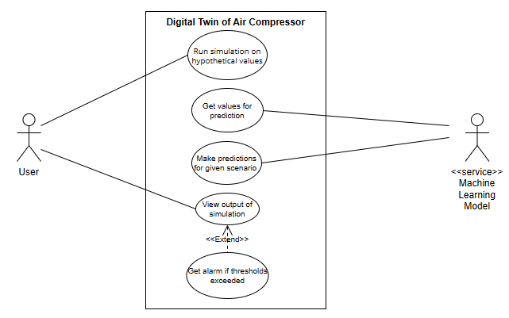
System Design (Team Approach)
Use-Case Diagram

Slide 20
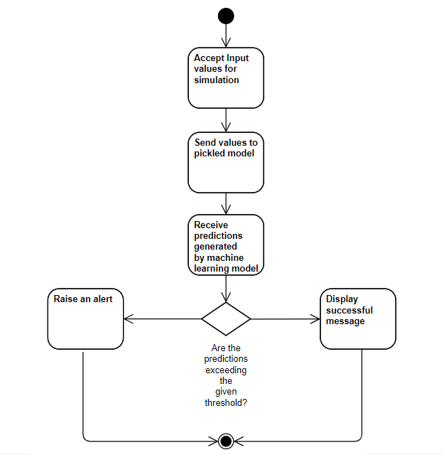
System Design (Team Approach) (Cont’d)
Activity Diagram

Slide 21
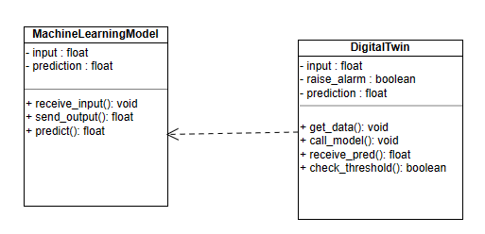
System Design (Team Approach) (Cont’d)
Class Diagram

Slide 22
Individual Modules
GRAPHICAL USER INTERFACE (GUI)
3D SIMULATIONS
SYSTEM MODULES
API FOR INTEGRATION
ML MODELS

Slide 23
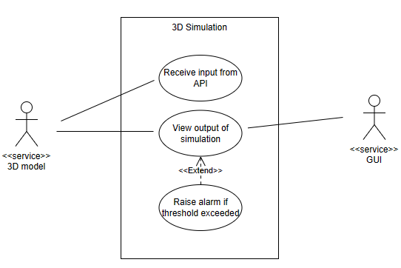
Module 1 - 3D Simulations
Use Case Diagram

Slide 24
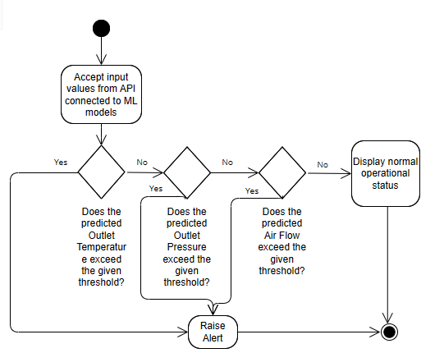
Module 1 - 3D Simulations (Cont’d)
Activity Diagram

Slide 25
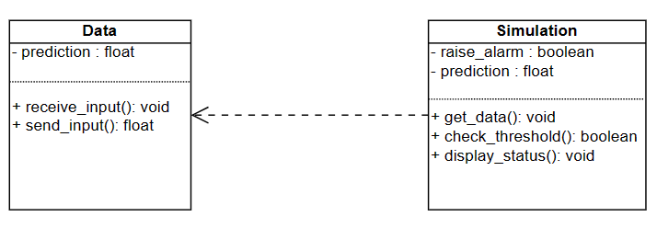
Module 1 - 3D Simulations (Cont’d)
Class Diagram

Slide 26
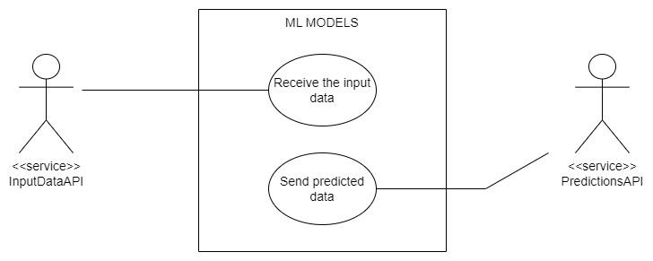
Module 2 - ML Models
Use Case Diagram

Slide 27
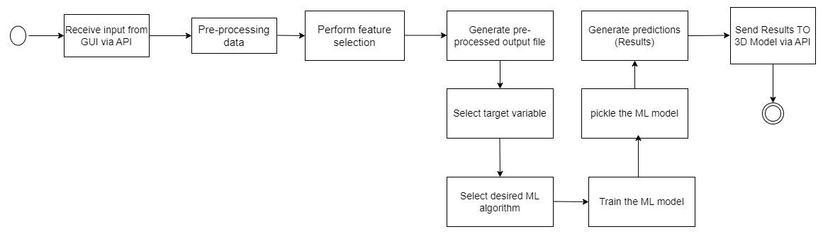
Module 2 - ML Models (Cont’d)
Activity Diagram

Slide 28
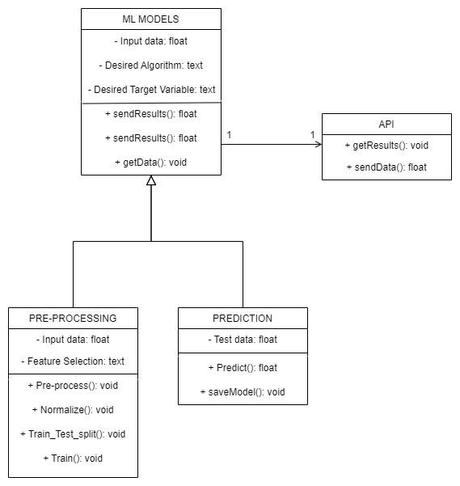
Module 2 - ML Models (Cont’d)
Class Diagram

Slide 29
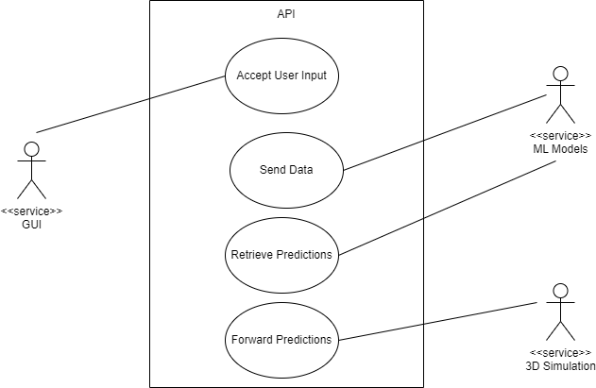
Module 3 - APIs for Integration
Use Case Diagram

Slide 30
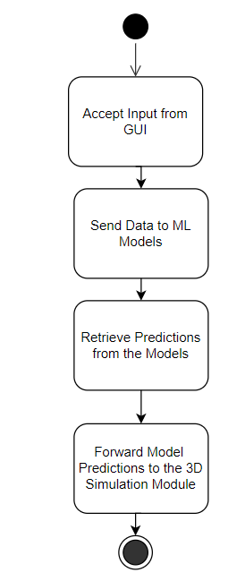
Module 3 - APIs for Integration (Cont’d)
Activity Diagram

Slide 31
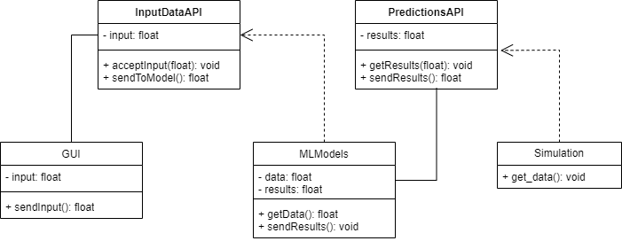
Module 3 - APIs for Integration (Cont’d)
Class Diagram

Slide 32
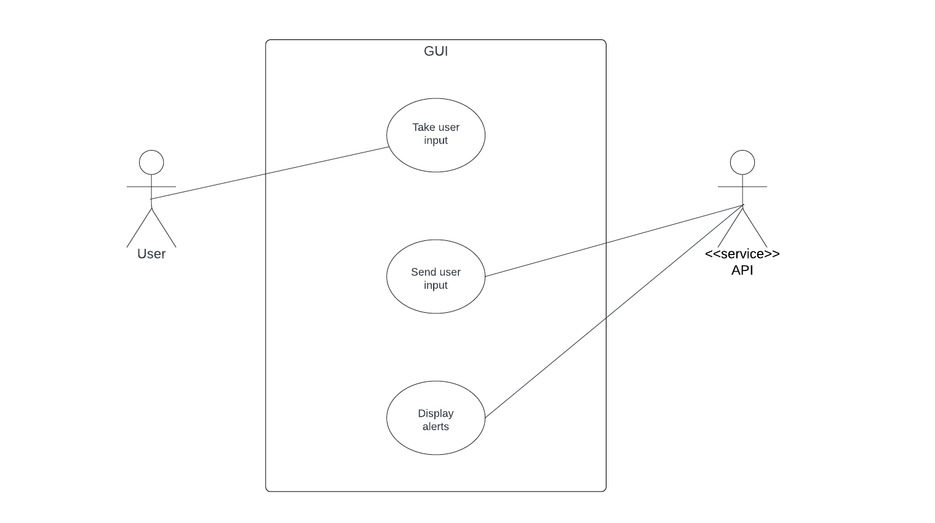
Module 4 - Graphical User Interface (GUI)
Use Case Diagram

Slide 33
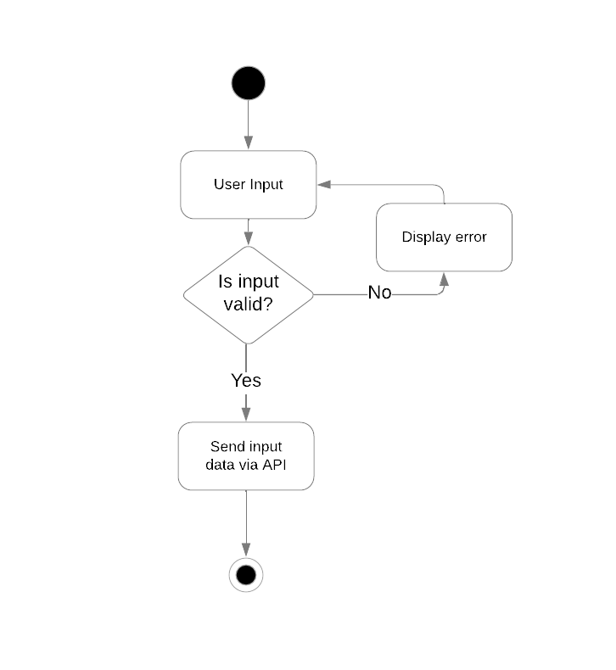
Module 4 - Graphical User Interface (GUI) (Cont’d)
Activity Diagram

Slide 34
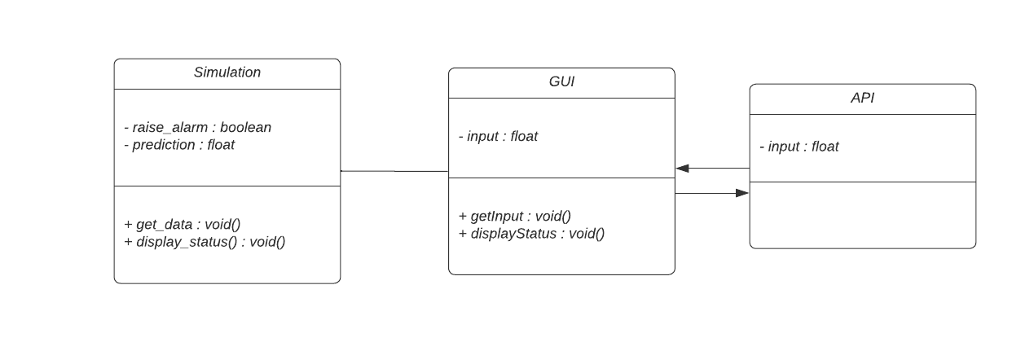
Module 4 - Graphical User Interface (GUI) (Cont’d)
Class Diagram

Slide 35
Progress Till Date - Data Acquisition and Preprocessing
Dataset sourced from Kaggle (https://www.kaggle.com/datasets/afumetto/predictive-maintenance-dataset-air-compressor)1000 samples, 26 features for a single - stage reciprocating compressor
Adaptation for double stage reciprocating compressor: Air flow rate values doubled, dataset augmented
Textual feature conversion: Radiators, bearings, etc., encoded into numerical format
Examination of dataset's frequency distribution: Graphical representation of various features
Correlation heatmap analysis: Selection of features for optimal output

Slide 36
Progress Till Date - Data Acquisition and Preprocessing (Cont’d)
Processed data saved in (.csv) file for future use in Machine Learning models
Real data from MIT-subsea system to replace current dataset soon
Correlation heatmap-guided feature selection: Eliminated less correlated features
Final dataset: 1000 samples, 17 features for training ML models

Slide 37
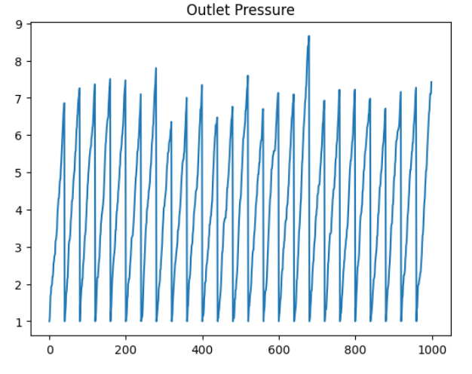
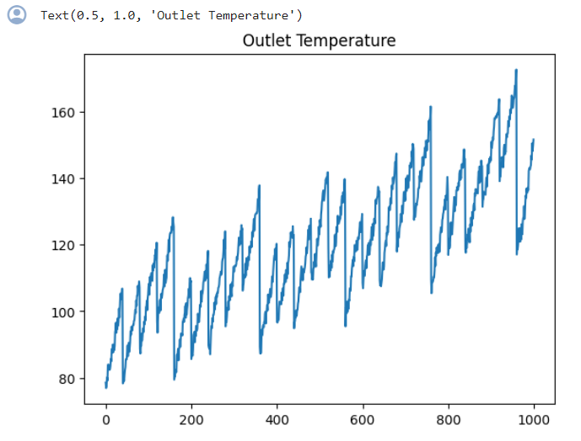
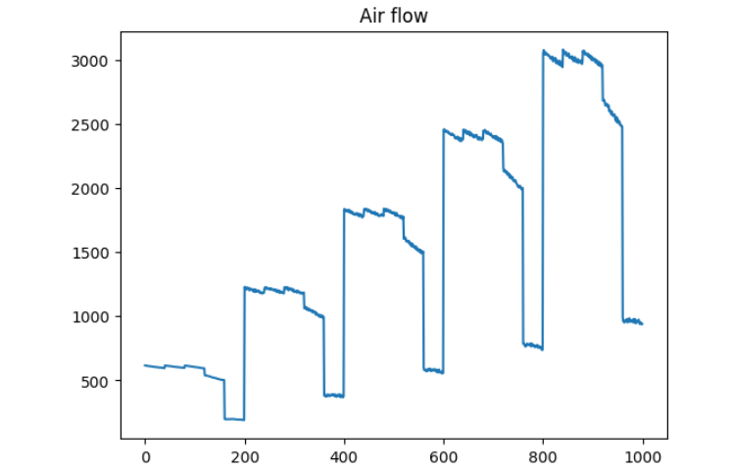
Progress Till Date - Data Visualisation
(a) (b) (c)
Fig. 1 Visualising the data for target variables (a) Outlet Pressure, (b) Outlet Temperature and (c) Airflow

Slide 38
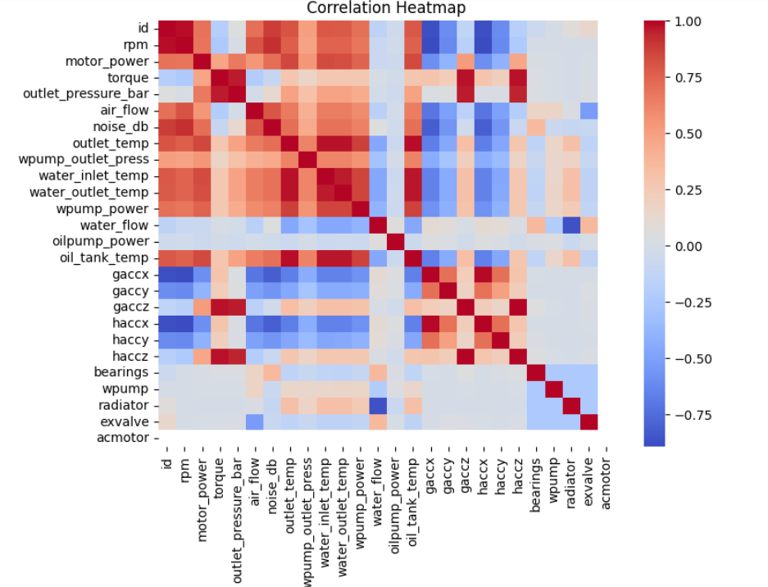
Progress Till Date - Data Visualisation (Cont’d)
Fig. 2: Correlation Matrix of all Features against each other

Slide 39
Progress Till Date - Machine Learning
Target Variables chosen:
Outlet Temperature (Farenheit (⁰F))
Outlet Pressure (Bar)
Air Flow (Litres per min (L/min))
Models worked on:
Random Forest
Long Short Term Memory (LSTM)
Polynomial Regression

Slide 40
Progress Till Date - Machine Learning (Cont’d)
KNN
AdaBoost
Gradient Boosting
SVR
Multi Linear Regression
After hyperparameter tuning all models, Polynomial Regression yielded the best accuracy for most of the target variables.

Slide 41
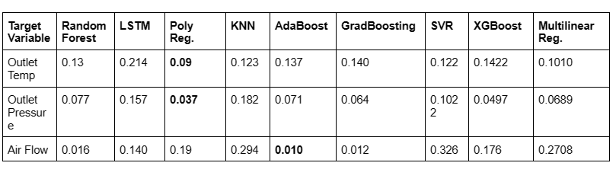
Progress Till Date - ML Model Results

Slide 42
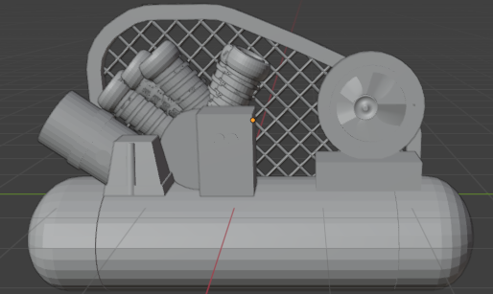
Progress Till Date - 3D Model

Slide 43
Work in Progress
Integration of 3D Models integration:
Connect with API:
Develop a connection between Blender and the API endpoints responsible for fetching predicted values from the machine learning models. This may involve writing scripts or plugins within Blender to handle communication with the API.
Fetch Predicted Values:
Implement functionality within Blender to fetch predicted values from the API based on the current state of the compressor system. This may include passing relevant parameters or data to the API and processing the returned predictions within Blender.

Slide 44
Work in Progress (Cont’d)
Visualisation of Predicted Values:
Once predicted values are fetched from the API, integrate them into the Blender models to visualize the predicted behavior or performance of the compressor system. This could involve updating the appearance or properties of certain components based on the predictions.
Testing and Validation:
Test the integration between Blender, the 3D models, and the API to ensure that predicted values are accurately fetched and visualized within the Blender environment. Validate the accuracy and reliability of the predictions against known data or simulation results.

Slide 45
Work in Progress (Cont’d)
GUI Development:
Design Input Controls:
Design input controls such as text field and buttons within the GUI to allow users to input relevant data or parameters. Consider the type of inputs required for controlling the 3D model or triggering specific actions.
Validate User Inputs:
Implement validation mechanisms to ensure that user inputs are within acceptable ranges or formats. Display error messages or visual indicators to prompt users to correct invalid inputs before proceeding.

Slide 46
Work in Progress (Cont’d)
Send User Inputs to API:
Define protocols for sending user inputs from the GUI to the API. This may involve constructing requests containing input data and sending them to specific API endpoints for processing.
Receive Responses from API:
Handle responses received from the API after processing user inputs. Update the GUI interface or display relevant information based on the API's response, such as updated visualizations or alerts triggered by user inputs.

Slide 47
References
[1] Segovia, M., & Garcia-Alfaro, J. (2022). Design, modeling and implementation of digital twins. Sensors, 22(14), 5396.
[2] Chen, B. Q., Videiro, P. M., & Guedes Soares, C. (2022). Opportunities and challenges to develop digital twins for subsea pipelines. Journal of Marine Science and Engineering, 10(6), 739.
[3] Sharma, A., Kosasih, E., Zhang, J., Brintrup, A., & Calinescu, A. (2022). Digital twins: State of the art theory and practice, challenges, and open research questions. Journal of Industrial Information Integration, 30, 100383.
[4] Prokhorenko, A., Kravchenko, S., & Solodkii, E. (2021). Digital twin of gas reciprocating compressor unit: concept, architecture & pilot implementation.
[5] Wei, L., Pu, D., Huang, M., & Miao, Q. (2020). Applications of digital twins to offshore oil/gas exploitation: From visualization to evaluation. IFAC-PapersOnLine, 53(5), 738-743.
[6] Mihai, S., Yaqoob, M., Hung, D. V., Davis, W., Towakel, P., Raza, M., ... & Nguyen, H. X. (2022). Digital twins: A survey on enabling technologies, challenges, trends and future prospects. IEEE Communications Surveys & Tutorials, 24(4), 2255-2291.

Slide 48
References (Cont’d)
[7] Liu, M., Fang, S., Dong, H., & Xu, C. (2021). Review of digital twin about concepts, technologies, and industrial applications. Journal of manufacturing systems, 58, 346-361.
[8] Ge, W., He, R., Wu, Q., Cai, B., Yang, C., & Zhang, F. (2023). Digital twin driven fault diagnosis method for subsea control system. IEEE Access.
[9] Wanasinghe, T. R., Wroblewski, L., Petersen, B. K., Gosine, R. G., James, L. A., De Silva, O., ... & Warrian, P. J. (2020). Digital twin for the oil and gas industry: Overview, research trends, opportunities, and challenges. IEEE access, 8, 104175-104197.
[10] Liu, Zheng & Blasch, Erik & Liao, Min & Yang, Chunsheng & Tsukada, Kazuhiko & Meyendorf, Norbert. (2023). Digital twin for predictive maintenance. 6. 10.1117/12.2660270.
[11] Zhong, Dong & Xia, Zhelei & Zhu, Yian & Duan, Junhua. (2023). Overview of predictive maintenance based on digital twin technology. Heliyon. 9. e14534. 10.1016/j.heliyon.2023.e14534.
[12] Wenqiang, Yang & Bao, Xiangyu & Zheng, Yu. (2022). Digital Twin Approach to Build Predictive Maintenance Model and Its Case Study. 10.1115/DETC2022-89357.

Slide 49
Thank You

